Slide 1
Dr. Auto
Group C

Slide 2
Task Board

Slide 3
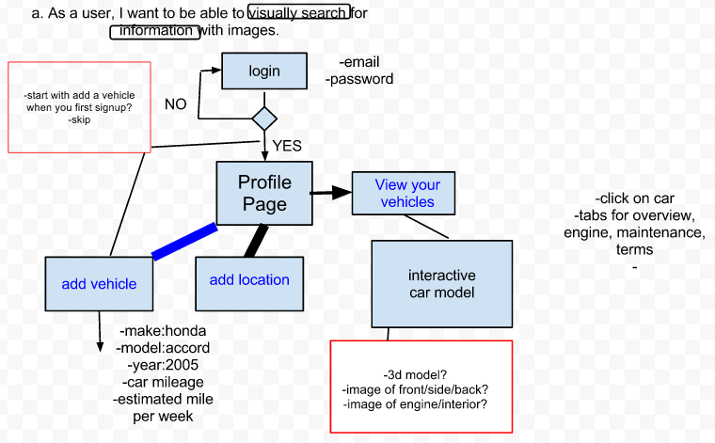
User Journey

Slide 4
Wireframes

Slide 5
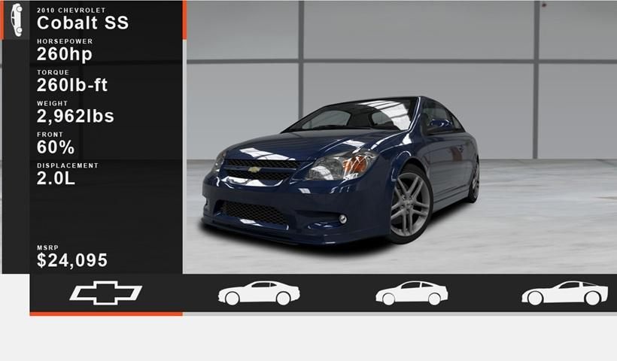
Site Mockup Screen Shot

Slide 6
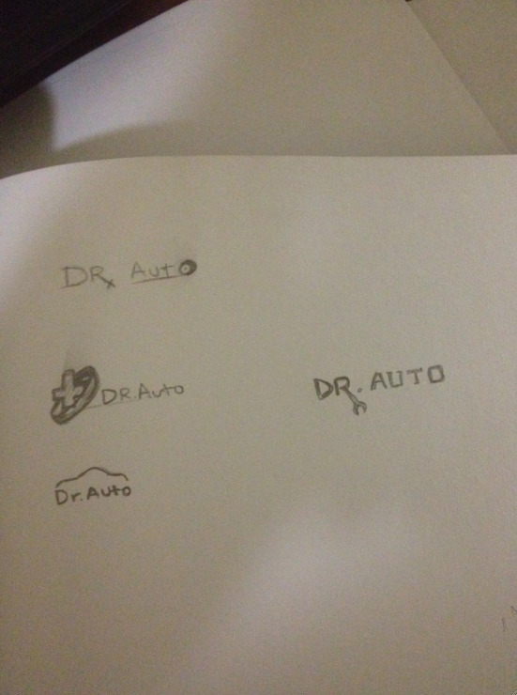
Logo sketches

